Slide 1


Y’All TRYNA BYPASS PYTHON 3.8 Audit hooks or nah?

Slide 2
getpass.getuser()
Leron Gray
aka daddycocoaman
https://daddycocoaman.dev
https://github.com/daddycocoaman
Ten year Navy veteran
Former NSA operator
Microsoft Azure Red Team
Lover of Python and Pythonic things
Also a nerdcore rapper (Ohm-I)
https://mcohmi.com

Slide 3
Outline
Python 2 vs 3
Python 3 Features
Summary of PEP 578/551
Implementing audit hooks
Bypassing audit hooks (for Windows)
A step further
It’s dope, I promise

Slide 4
PYTHON 2 vs PYTHON 3

Slide 5

Python 2
Are you still using Python 2?

Slide 6
Comparing 2 vs 3
Python 2
Python 3
End of life on 1/1/2020
ASCII strings
Print as a statement
print “hello world”
Division
5 / 2 = 2
5 / 2.0 = 2.5
Library names
import SimpleHTTPServer
Import StringIO
It’s the new new.
Unicode strings
Print as a function
print(“hello world”, end=“.”)
Division
5 / 2 = 2.5
5 // 2 = 2
Library names
import http.server
Import io

Slide 7
Major Python 3.5 – 3.7 changes
Python 3.5
async/await
Python 3.6
F-strings
name = “daddycocoaman”
print(f“My name is {name}”)
Ordered dictionaries
Python 3.7
Better async/await (reserved keywords)
breakpoint() function to enter debugger
@dataclass decorator (for struct-like classes)
https://docs.python.org/3/whatsnew/3.5.html https://docs.python.org/3/whatsnew/3.6.html
https://docs.python.org/3/whatsnew/3.7.html

Slide 8
Python 3.8 Changes
Walrus operator
Can assign values while evaluating an expression
asyncio enabled REPL
python –m asyncio
Audit hooks
Hooking runtime events to perform some action
if (n := len(a)) > 10: print(f"List is too long ({n} elements, expected <= 10)")
https://docs.python.org/3/whatsnew/3.8.html

Slide 9
PEP 551/578

Slide 10
PEP 551
Proposal for implementation of audit hooks for security for sysadmins
Suggestions for OS specific features to integrate (AMSI, Script Block, syslog, auditd)
Recommendation to modify entry point of Python executable in production
Restrict importable modules
Remove command line arguments (-m, -c)
Repeatedly suggests detecting code in hooks over prevention
Implement OS security features to protect modified Python
Device Guard for Windows (EXE signing, catalog files)
xattr for *nix (add file attributes with hashes for permitted .py files)
https://www.python.org/dev/peps/pep-0551

Slide 11
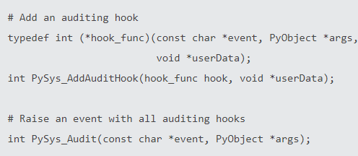
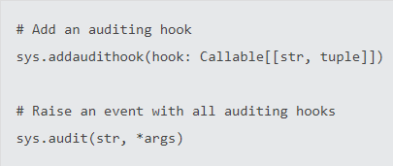
PEP 578
Discusses how audit hooks are implemented at runtime
Can implement in executable or inside of script:
C level APIs Python API
Harder to implement (requires C knowledge)
Requires recompiling a new executable
Hooks will apply to all code run by new EXE
Easier to implement (written in Python)
No compiling required
Will only apply to script where implemented
https://www.python.org/dev/peps/pep-0578

Slide 12
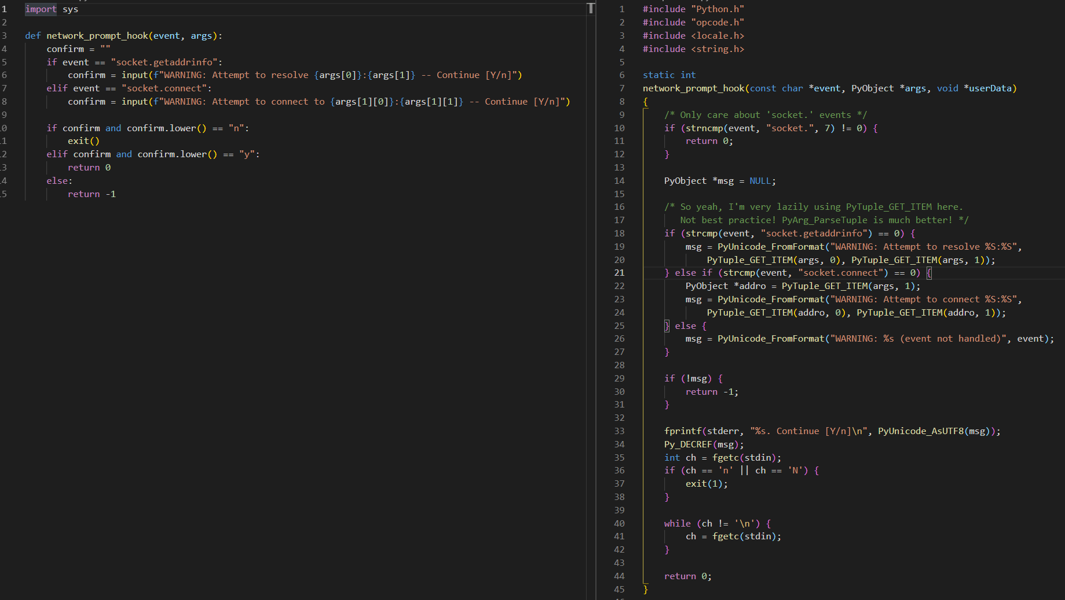
https://github.com/zooba/spython/tree/master/NetworkPrompt

Slide 13
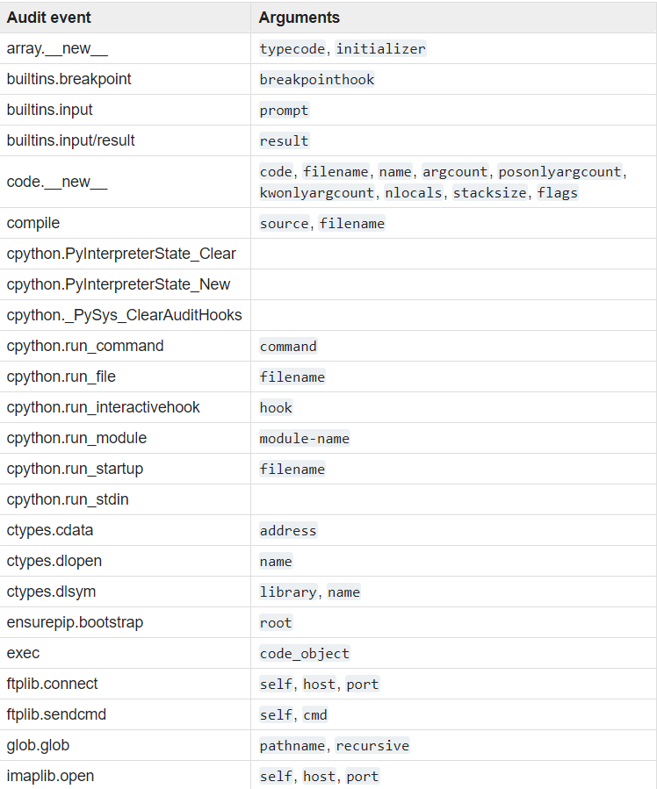
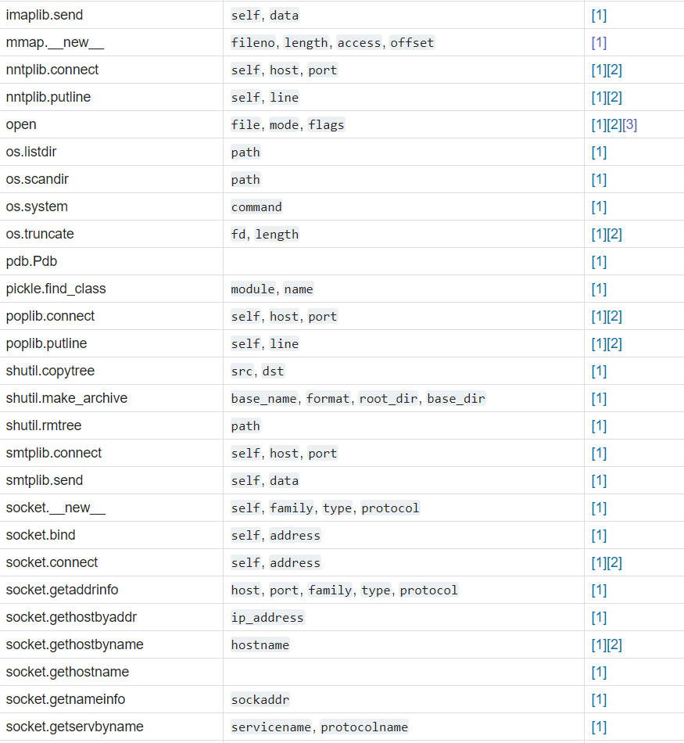
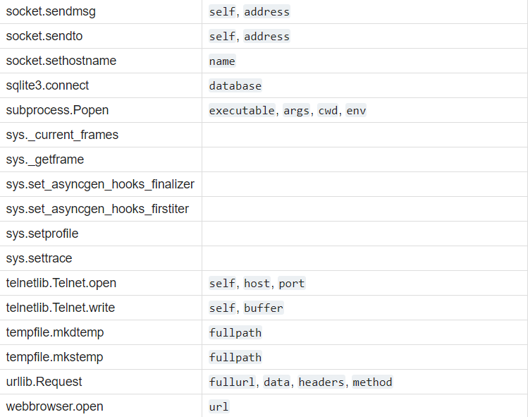
List of Audit Hooks
https://docs.python.org/3.8/library/audit_events.html

Slide 14


DETECTION PREVENTION

Slide 15
Implementing audit hooks demo

Slide 16
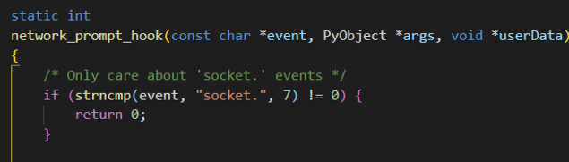
How auditing works
When an action of interest is executed, Python determines whether or not the action matches an audit rule.
All audit hooks are processed for all events.
Opening a file is still passed to network_prompt_hook function but won’t do anything since it doesn’t meet the defined condition.

Slide 17
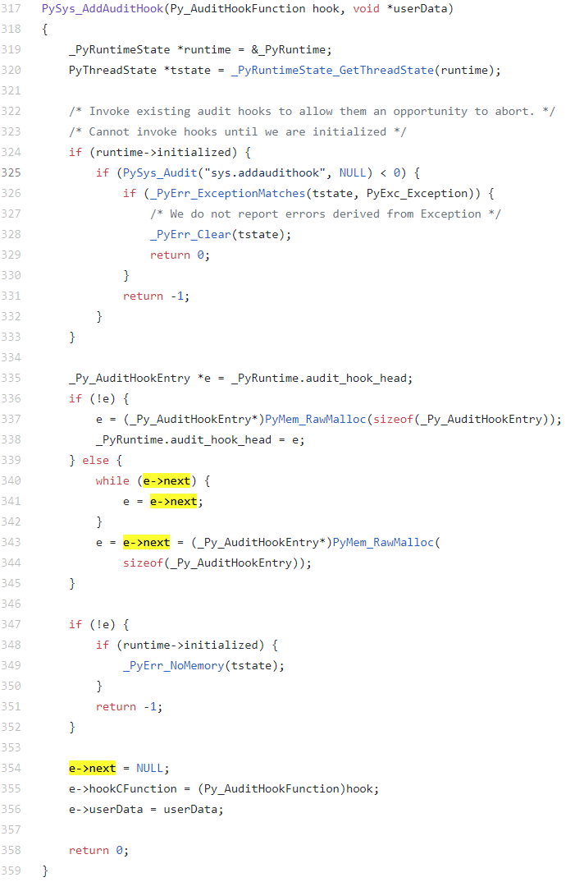
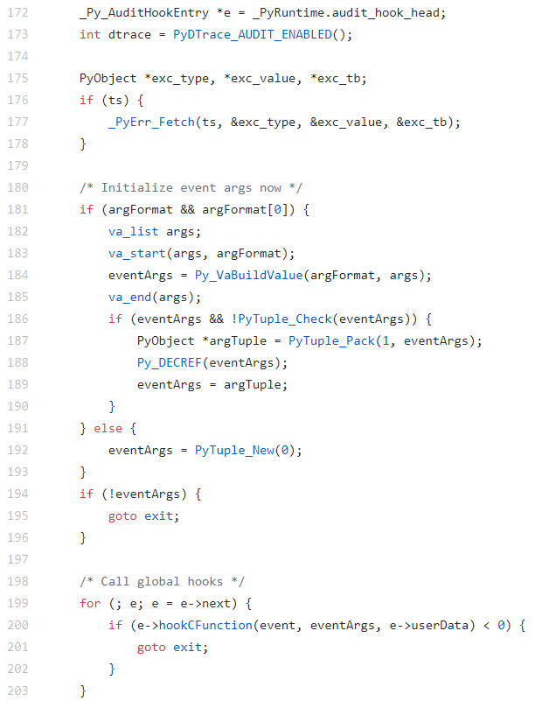
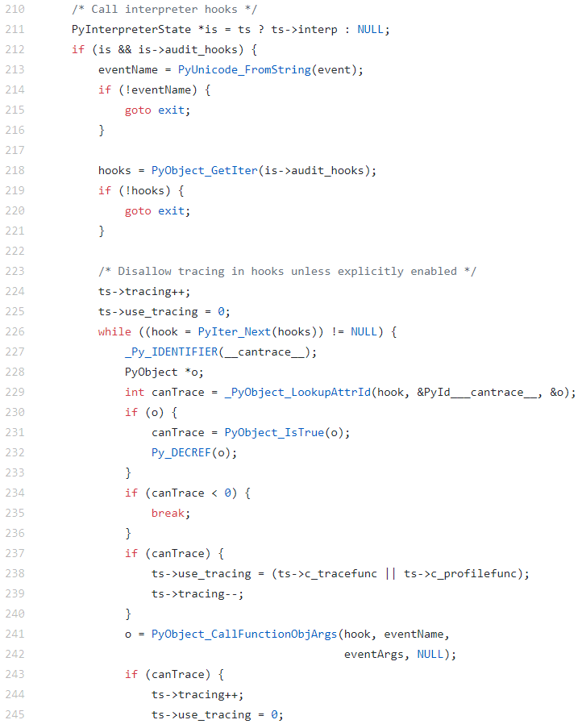
sysmodule.c

Slide 18
Bypass Ideas
Audit hooks cannot be cleared once set but maybe we can:
Overwrite the head of the linked list to point to null
Might be possible
Attempting to locate the start of the linked list might be hard
Disclaimer: I’m new to this level of exploit dev so it might be easy for some!
Overwrite the bytes in memory that calls the hook functions
Smells a lot like PowerShell and AMSI bypassing
Plenty of resources to draw inspiration from
https://www.mdsec.co.uk/2018/06/exploring-powershell-amsi-and-logging-evasion/
Significantly easier to determine address to overwrite
WINNER!

Slide 19
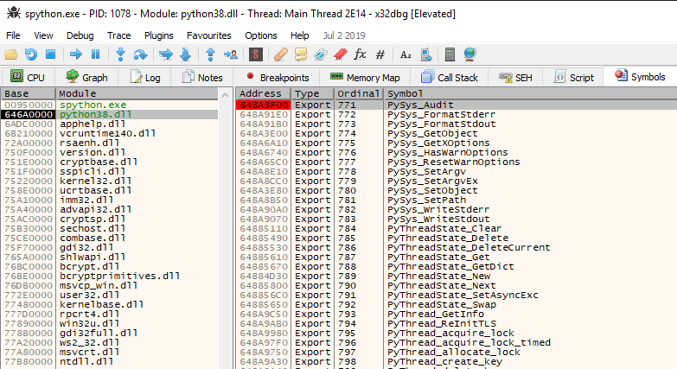
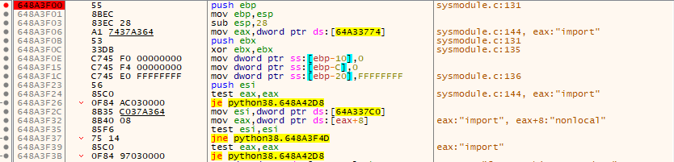

Slide 20
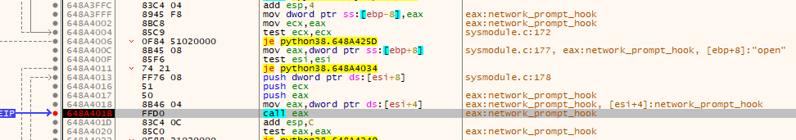
EAX holds address to hook function
call eax can be overwritten with NOPs so that the function never gets called!

Slide 21
BYPASSING audit hooks (Finally)

Slide 22
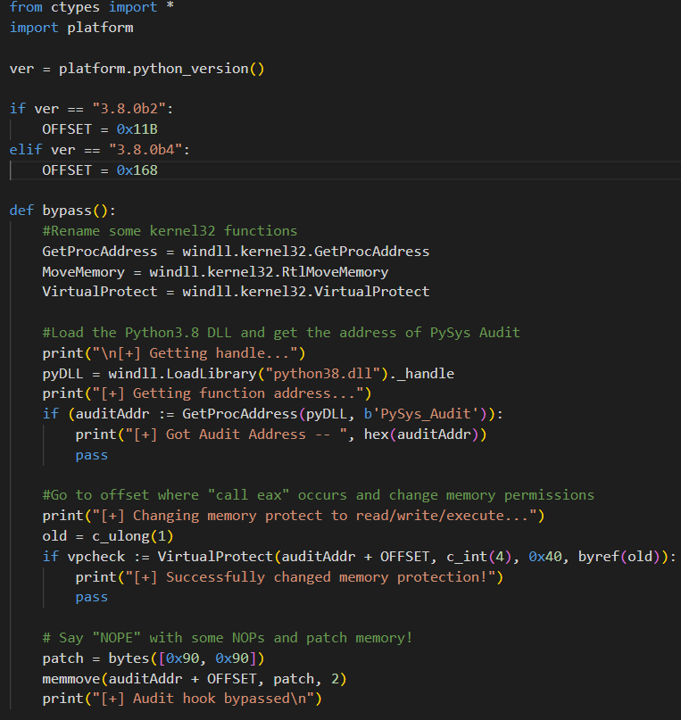

Extremely similar to AMSI bypasses
 | PYTHON | POWERSHELL
Load | Python38.dll | Amsi.dll
Get Address | PySys_Audit | AmsiScanBuffer
Change memory permissions
Overwrite | NOPs | Bunch of Bytes
Note: So far, different releases appear to have different offsets, so each version should be tested.

Slide 23
Detection
While this method works, it can be easily be detected.
All audit hooks are in effect until the call to memmove.
Proper logging with audit hooks provides insight on bypassing in this method.
However, might be hard for non-C programmers to implement.
It would be great if someone came up with a template of audit options and actions to help sysadmins compile custom Python.
Not me

Slide 24
A Step Further

Slide 25

A step further
Since the bypass is easy to detect until bytes are patched, is there any other method to bypass?
Might be other ways to load and patch DLLs
But they still have to run in context of Python interpreter
Can we run Python without running a Python executable?

Slide 26
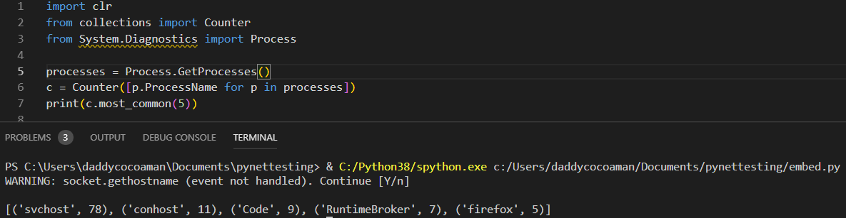
THE ANSWER IS YES!
pythonnet - Python package that allows access to .NET Common Runtime Language (CLR) from CPython.
This is NOT an IronPython implementation
Syntax is similar to IronPython but still remains a CPython implementation
Does not officially support Python 3.8 yet but development wheel can be installed
BUT WAIT THERE’S MORE!
https://github.com/pythonnet/pythonnet

Slide 27
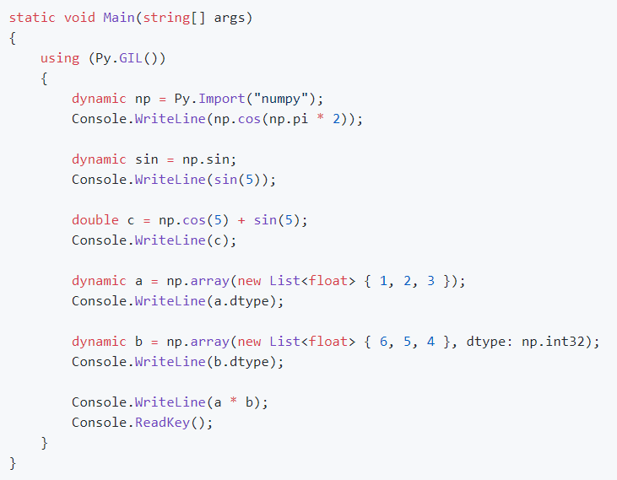
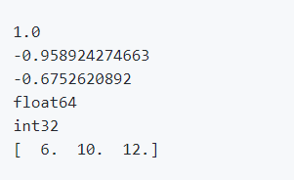
Embedding Python in .NET
pythonnet also comes with a .NET assembly that can be used with .NET languages to run Python.
Python types are written in C# in source code and are compiled as part of .NET assembly
Requirement:
PATH variable must include directory with Python runtime installed (python3X.dll)
Allows code to be passed to Python’s GIL
We can import!
https://github.com/pythonnet/pythonnet

Slide 28
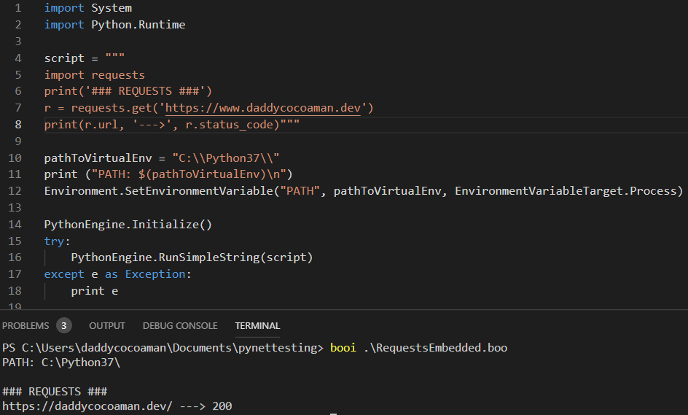
Embedding Python in .NET
We could use C# to write this code but I like Boolang. https://github.com/boo-lang/boo
Unfortunately, the current versions of Python.Runtime.dll do not work yet with Python 3.8.
But we can still create this proof of concept for running Python without touching the Python EXE.
All we need to do is point the PATH variable for the process to a Python installation folder.
HMMMMMM…….

Slide 29

PATH Variable
The PATH variable can be set to any folder on disk.
…or a network share

Slide 30
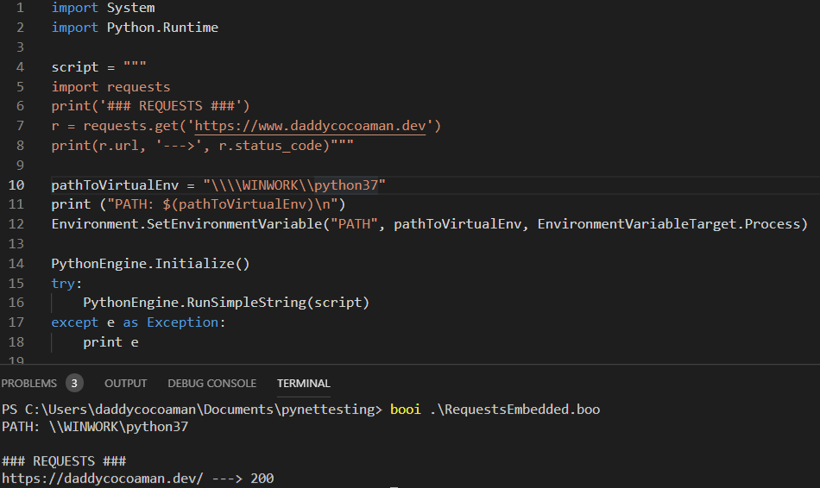
Python across a Network Share
The PATH variable can be set to \\SERVER\Share, just as long as it points to a Python 3.X install!

Slide 31
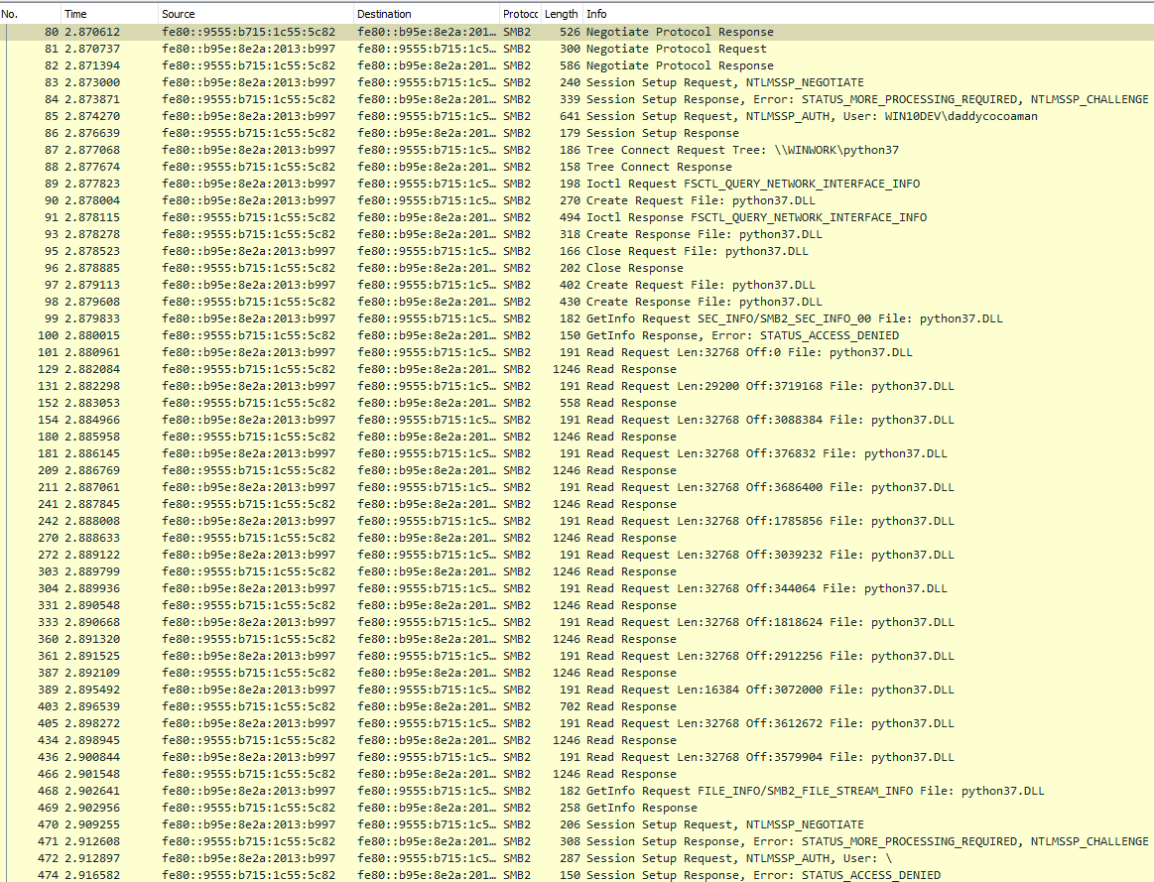
Extremely noisy cleartext traffic. ☹
But if we can use SMB, maybe we can use WebDAV!

Slide 32
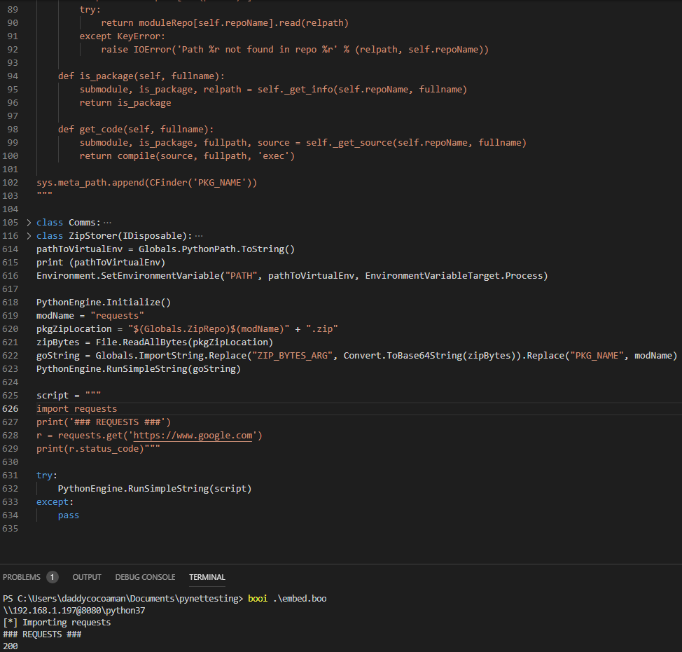
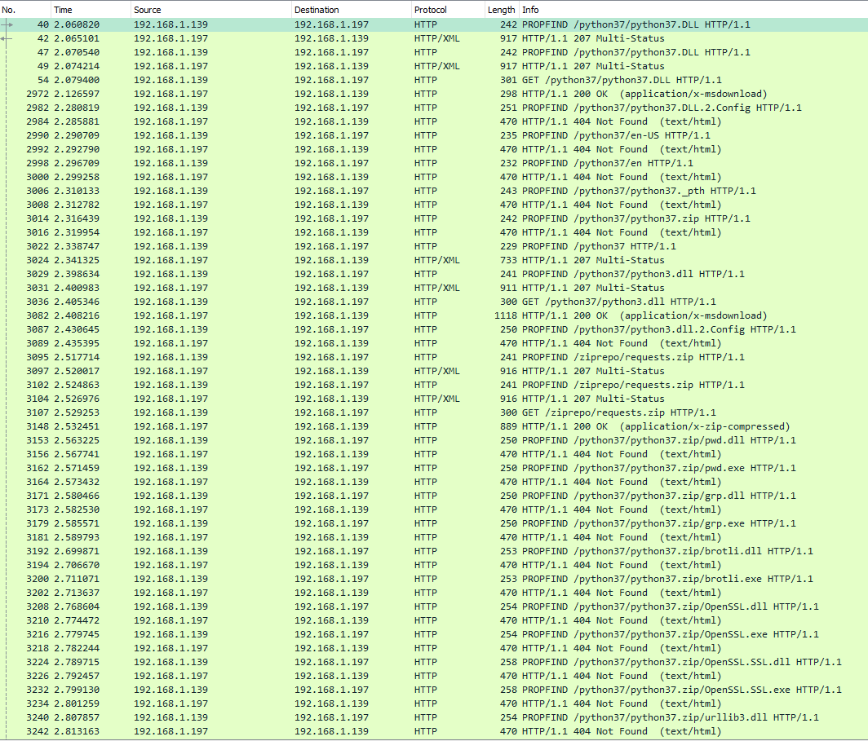
Python across WebDAV
The PATH variable can be set to \\SERVER@Port. (SSL optional)

Slide 33
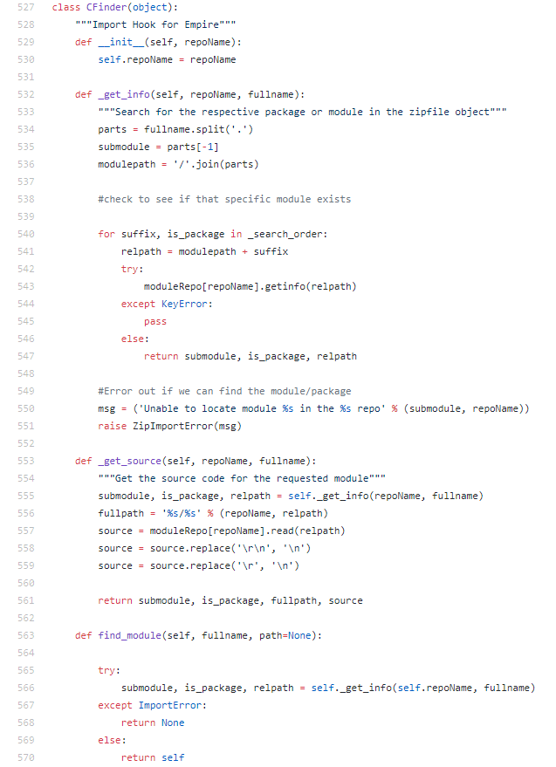
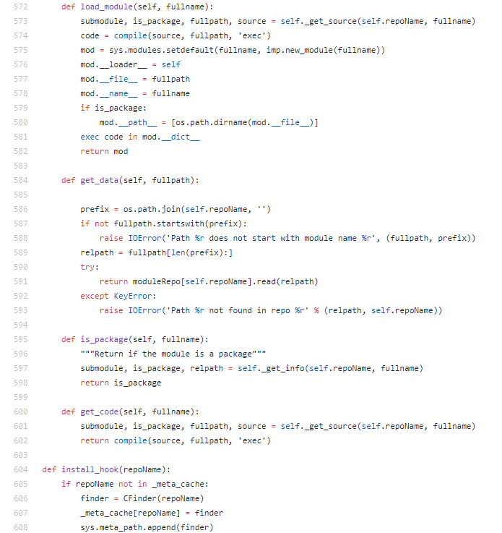
Embedding Python in .NET
We can also host our own repo to remotely load packages. No need to pip install on target box.
Empire toolkit does this by implementing a custom import hook that allows you to modify the logic in how modules are loaded.
This code is noticeably in Python 2.
https://www.xorrior.com/In-Memory-Python-Imports/
https://github.com/sulinx/remote_importer

Slide 34
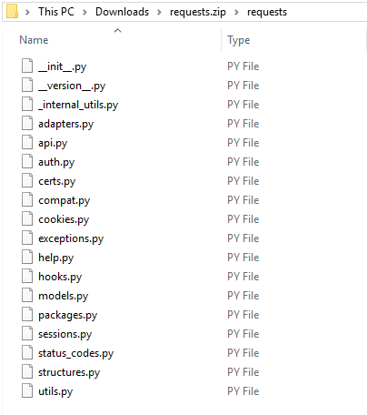
Embedding Python in .NET
Packages need to be in standard format.

Slide 35
ScarySnake demo

Slide 36
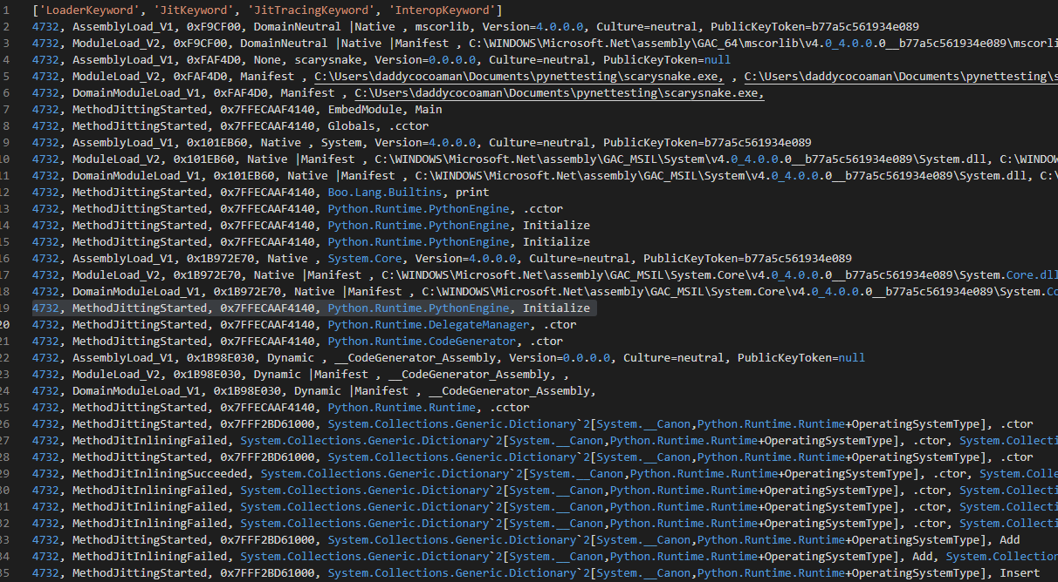
Detection
Probably a bit difficult to detect on the host if successfully executed.
If collecting ETW logs, you will definitely see Python.Runtime loaded.
For remote loading, monitoring network traffic is important.
https://www.countercept.com/blog/detecting-malicious-use-of-net-part-1/ https://github.com/fireeye/pywintrace

Slide 37




Thanks
Steve Dower - @zooba
Python core dev
Marcello Salvati - @byt3bl33d3r
Embedding Scripting Evangelist
Chris Ross - @xorrior
Empire dev/Custom import hook
Adam Chester - @_xpn_
AMSI Bypasses

Slide 38
QUESTIONS?
https://daddycocoaman.dev
https://github.com/daddycocoaman
Twitter - @mcohmi

